Slide 1
VOICE MORPHING

Slide 2


voice morphing
PRESENTED BY
MOHAMMED ARIF T(MES21MCA-2023)
GUIDED BY
SYED FEROZE AHAMED M
ASST.PROFESSOR
MES COLLEGE OF ENGINEERING KUTTIPURAM
Date:10-03-2023,FRIDAY

Slide 3
CONTENTS
Voice morphing
INTRODUCTION.
HOW VOICE MORPHING WORKS
PROCESS VOICE MORPHING
MAGIC MIC
CAPABILITIES OF AI VOICE GENERATION
FUTURE OF AI VOICE GENERATION
COMPARISON OF VOICE CHANGER AND TTS
APPLICATIONS
ADVANTAGES AND DISADVANTAGES
CONCLUSION
REFERENCES

Slide 4
INTRODUCTION
Voice morphing
Voice morphing means the smooth transition of one speech signal to another, such as male to female, female to male, robot……
Pitch and Envelop Information are the two major properties of Speech signal. This can change the pitch, tone, and other aspects of the voice to make it sound different.
Some voice morphing software also includes advanced features like artificial intelligence and neural networks, machine learning which can be used to create highly realistic and natural-sounding voices

Slide 5
Cont…
Voice morphing
Training and conversion are two important stages in voice morphing.
Training: This includes segmentation of the source and target speaker voices in into equal frames then analyzing it is based upon a Linear Predictive Coding model. This is done in order to extract vocal features to be transformed
Conversion: This involves features transformation from source to target. In order to have a better alignment between source and the target features, there is an application of Dynamic Time Warping

Slide 6
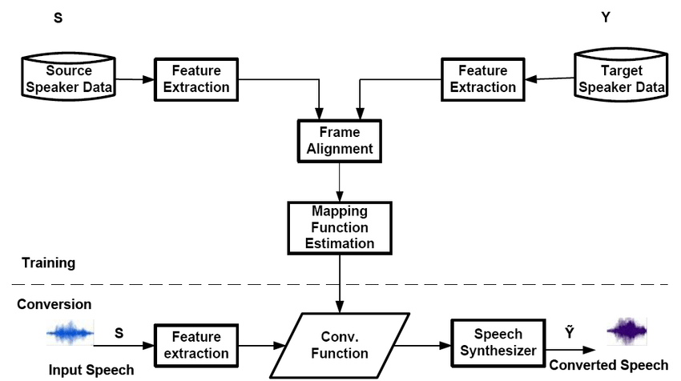
HOW VOICE MORPHING WORKS..
Voice morphing

Slide 7
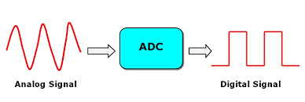
PROCESS OF VOICE MORPHING
Voice morphing
Signal Acquisition:
Speech signal is captured then amplified and filtered to remove any noise or interference.
CODEC Method used to analog speech signal is converted into the discrete form
Such as analog-to-digital converter (ADC)

Slide 8

Cont…
Voice morphing
Windowing:
The windowing process helps to improve the quality of the morphed voice by reducing distortion.
windowing process involves dividing the speech signal into small frames or windows, typically ranging from 20 to 40 milliseconds in length. Each window is multiplied by a windowing function Hanning, which reduces the amplitude of the signal at the beginning and end of the window.

Slide 9
Cont…
Voice morphing
Warping
Warping of voice involves modifying the pitch and tempo of a voice, or correcting for distortions caused by changes in the recording environment.
Dynamic Time Warping is a powerful tool for voice morphing because it can handle complex variations in speech, such as changes in speaking rate, pronunciation, and accent.
DTW align the speech signals of the source and target speakers. This alignment allows for a frame by frame comparison of the two signals.

Slide 10
Cont…
Voice morphing
Continuous….
signal re-estimation
signal re-estimation is the process of generating a new speech signal from the transformed speech signal to make it sound more natural and human-like
signal re-estimation is to use a technique known as spectral smoothing or spectral shaping.
These frames are then converted back into a time domain waveform using the signal re-estimation

Slide 11
MAGIC MIC
Voice morphing
MagicMic is a real-time voice changer so it automatically converts the voice into the selected voice.
Main features are voice and sound effects, AI voice cloning, voice customization, keybinds control, voice changing background sound,
It comes with 125+ voice-changing options , including AI voices. Some of them come with background sounds.
You can import MP3/MAV audio files

Slide 12
Cont…
Continuous….
Voice morphing
Set keybind for voice and sound effects so that you can play and stop them quickly while gaming or live.
Customize your special and unique voice for it with the voice studio.
Some voice effects come with background sounds so that you can change the environment and change your voice more naturally.
It can work for various platforms like PUBG, Second Life, Fortnite, Skype, live streaming, online education, entertainment prank
400+ Voice Effects and 150+ Voice Memes.

Slide 13
CAPABILITIES OF AI VOICE GENERATION
Voice morphing
MURF AI
Murf AI is a cloud-based realistic text-to-speech(TTS) platform that can be used to create voiceovers for their content.
AI and deep machine learning technology to generate these ultra-realistic voiceovers
across a range of 120+ voices in 20+ languages.
AI voices are synthetic voices that mimic human speech through a process called deep learning.

Slide 14
Cont…
Voice morphing
where artificial intelligence is used to convert text into speech.
AI offers great creative control by letting users fine-tune the punctuation, pitch, interjections, speed, emphasis, and tone of an AI voice.
It mainly used to YouTube videos, podcasts, advertisements/ commercials, e-learning content, presentations, audiobooks, etc……

Slide 15
FUTURE OF AI VOICE GENERATION
Voice morphing
Continuous….
VALL E
Microsoft has introduced VALL-E, a neural codec language model method for text-to-speech synthesis (TTS) that employs audio codec codes as intermediate representations and can replicate anyone's voice
VALL-E could be used for high-quality text-to-speech applications, speech editing where a recording of a person could be edited and changed from a text transcript.
Simulate anyone’s voice with 3 seconds of audio

Slide 16
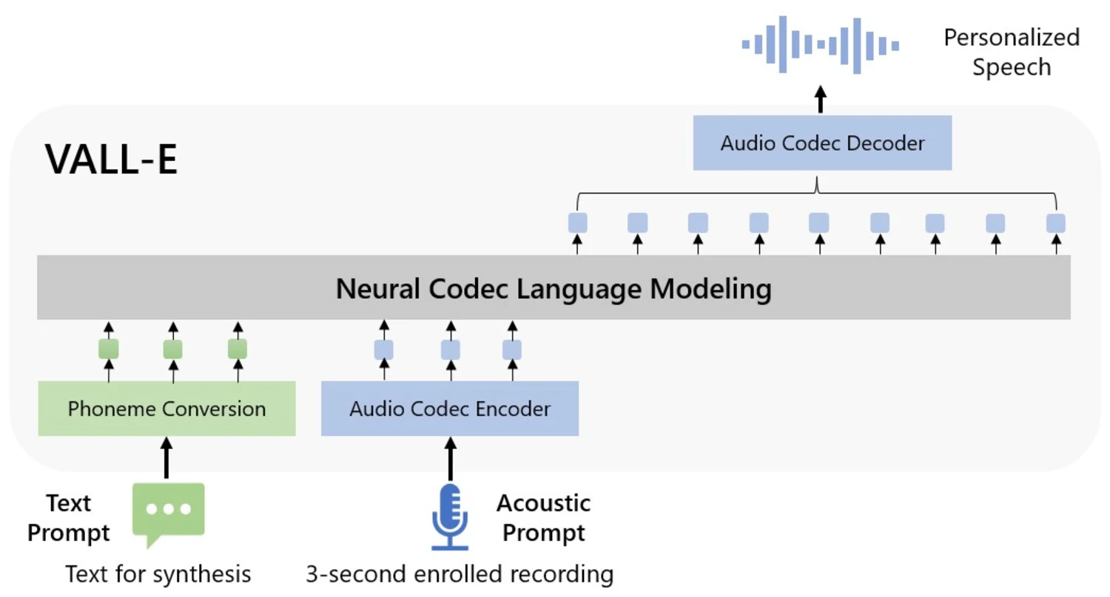
Voice morphing

Slide 17
COMPARISON OF VOICE CHANGER AND TTS
Voice morphing
Continuous….
VOICE CHANGER | TEXT-TO-VOICE(TTS)
modify an existing audio recording or live voice in real-time | convert written text into spoken words
used for entertainment purposes, such as video games or online chat | used for audiobooks, voice assistants, and navigation systems.
low-cost | Expensive
simpler signal processing techniques used | advanced machine learning algorithms used

Slide 18
APPLICATION
Voice morphing
Entertainment: movies, TV shows, and video games.
Medical: help people with voice disorders or speech impediments. By modifying the pitch or tone of a person's voice.
Accessibility: help people with disabilities, such as visual impairments or reading difficulties, to access written content. By converting text to speech.
Language translation
Voice assistants
Audiobooks

Slide 19
ADVANTAGES
Voice morphing
Continuous….
Versatility: used to create a wide range of different sounds and voices.
Forensics: helpful in forensic investigations to identify speakers and provide evidence in legal cases
Multilingual support: AI speech technology can be used to translate text from one language to another
Natural-sounding speech
Personalization
Entertainment

Slide 20
DISADVANTAGES
Voice morphing
Misuse: which can lead to identity theft, fraud, or other types of malicious activities.
Privacy concerns: Voice morphing technology can be used to generate someone's voice without their consent, leading to potential privacy concerns.
Legal issues: Voice morphing technology can raise legal issues around copyright, intellectual property, and privacy laws.
Lack of emotion
Mispronunciations

Slide 21
CONCLUSION
Voice morphing
Voice morphing technology has both advantages and disadvantages. It can be a versatile tool for creating a wide range of different sounds and voices,
Dynamic Time Warping of these contours aligns the sounds with respect to their pitches.
At each corresponding frame, the pitch and envelope information are separately morphed to produce a final morphed frame.
These frames are then converted back into a time domain waveform using the signal re-estimation

Slide 22
References
Voice morphing
[1] Voice Morphing by T. E. Martin, L. C. Neumeyer, and J. S. Garofolo.
[2] http://www.audio4fun.com
[3] http://www.ime.usp.br/~mqz/SMC010_Voice.pdf
[4] http://mi.eng.cam.ac.uk/~hy216/VoiceMorphingPrj.html

Slide 23

Voice morphing
THANKYOU…..

